Slide 1

Week 2
Task Based Placement Preparation Program(TBPPP) GLA University, Mathura

Slide 2
Topics covered this week
Understanding time and space complexity (Big O notation).
Introduction to basic data structures: Arrays and Linked Lists.
Operations on arrays (insertion, deletion) and linked lists (singly, doubly).

Slide 3

Significance and Applications
Real-Life Example: Data Structures in Action
Scenario: Imagine a ride-hailing app (like Uber or Ola):
Arrays: Used to store all the drivers' IDs available in a city for quick indexing.
Linked Lists: Used to manage the sequence of customer requests (e.g., ride booking queue).
Big O Notation: Ensures optimal matching of drivers and customers in minimal time, avoiding delays.

Slide 4
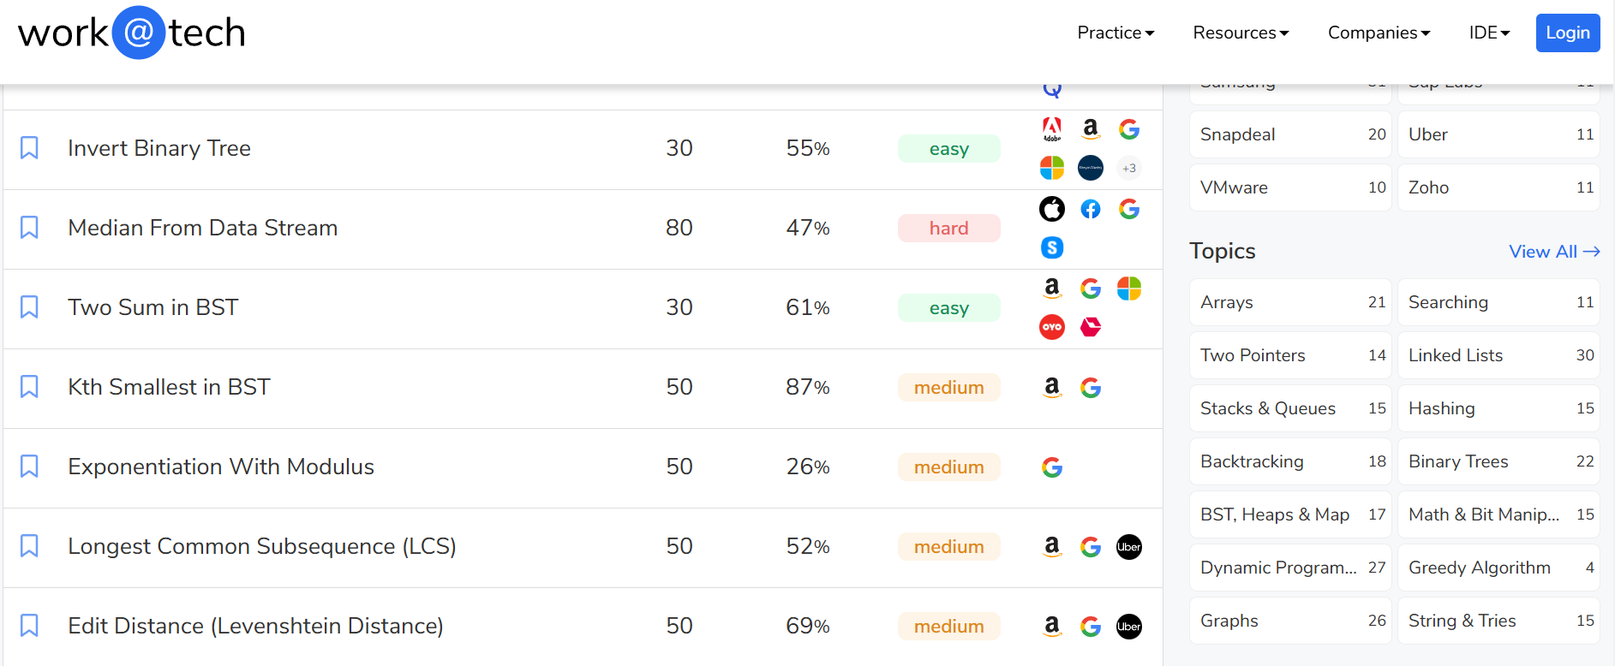
Placement Insights and Interview Relevance

Slide 5
Interactive Quiz and Knowledge Check
https://quizizz.com/admin/quiz/67811d120362053377dc2b2b

Slide 6
LeetCode Problem:
● LeetCode 26: Remove Duplicates from Sorted Array
● LeetCode 83: Remove Duplicates from Sorted List
● LeetCode 206: Reverse Linked List

Slide 7
CodeForces Problem
Codeforces 158A: Next Round – Array problem focusing on basic operations.
Codeforces 1374A: Required Remainder – Another array manipulation problem with conditions.
Codeforces 456A: Laptops – A problem based on sorting and arrays.

Slide 8
Collaborative Coding

Slide 9
Chapter 2 – Arrays

Slide 10
2.1 Arrays Hold Multiple values
Unlike regular variables, arrays can hold multiple values.

Slide 11
Figure 2-1
int count
Enough memory for 1 int
12345
float price
Enough memory for 1 float
56.981
char letter
Enough memory for 1 char
A

Slide 12
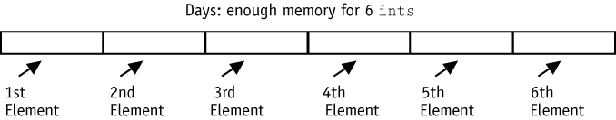
Figure 2-2

Slide 13
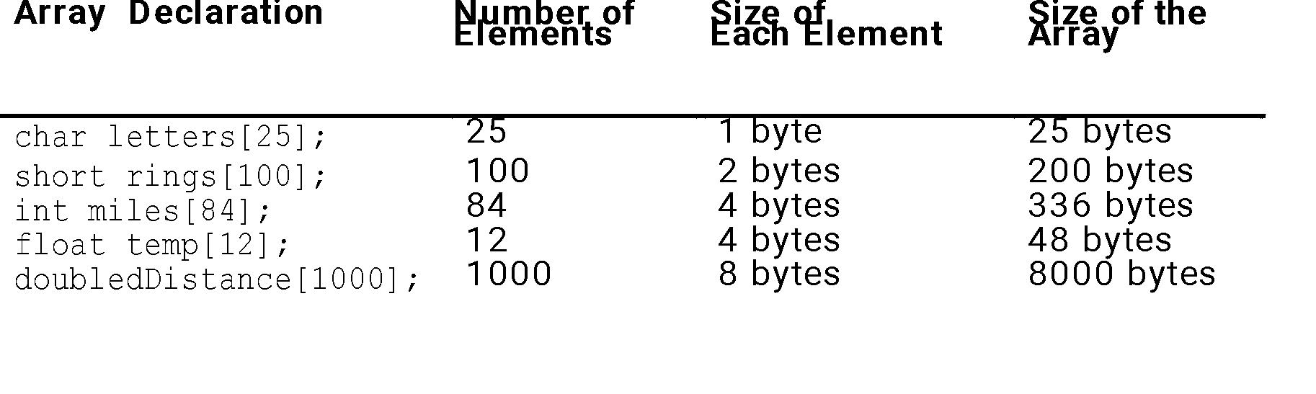
Table 2-1

Slide 14
2.2 Accessing Array elements
The individual elements of an array are assigned unique subscripts. These subscripts are used to access the elements.

Slide 15
Program 2-1
// This program asks the user for the number of hours worked
// by 6 employees. It uses a 6-element int array to store the
// values.
#include <iostream.h>
void main(void)
{
short hours[6];
cout << "Enter the hours worked by six employees: ";
cin >> hours[0];
cin >> hours[1];
cin >> hours[2];
cin >> hours[3];

Slide 16
Program continues
cin >> hours[4];
cin >> hours[5];
cout << "The hours you entered are:";
cout << " " << hours[0];
cout << " " << hours[1];
cout << " " << hours[2];
cout << " " << hours[3];
cout << " " << hours[4];
cout << " " << hours[5] << endl;
}

Slide 17
Program Output with Example Input
Enter the hours worked by six employees: 20 12 40 30 30 15 [Enter]
The hours you entered are: 20 12 40 30 30 15

Slide 18

Figure 2-3

Slide 19
Program 2-2
// This program asks the user for the number of hours worked
// by 6 employees. It uses a 6-element short array to store the
// values.
#include <iostream.h>
void main(void)
{
short hours[6];
cout << "Enter the hours worked by six employees: ";
for (int count = 0; count < 6; count++)
cin >> hours[count];
cout << "The hours you entered are:";
for (count = 0; count < 6; count++)
cout << " " << hours[count];
cout << endl;
}

Slide 20
Program Output with Example Input
Enter the hours worked by six employees: 20 12 40 30 30 15 [Enter]
The hours you entered are: 20 12 40 30 30 15

Slide 21
2.3 No Bounds Checking in C++
C++ gives you the freedom to store data past an array’s boundaries.

Slide 22
Program 2-4
// This program unsafely accesses an area of memory by writing
// values beyond an array's boundary.
// WARNING: If you compile and run this program, it could cause
// the computer to crash.
#include <iostream.h>
void main(void)
{
short values[3]; // An array of 3 short integers.
cout << "I will store 5 numbers in a 3 element array!\n";
for (int count = 0; count < 5; count++)
values[count] = 100;
cout << "If you see this message, it means the computer\n";
cout << "has not crashed! Here are the numbers:\n";
for (int count = 0; count < 5; count++)
cout << values[count] << endl;
}

Slide 23
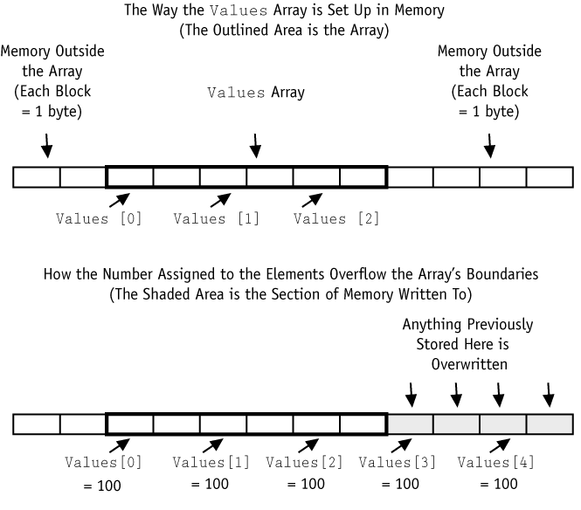
Figure 2-4

Slide 24
2.4 Array Initialization
Arrays may be initialized when they are declared.

Slide 25
Program 2-5
// This program displays the number of days in each month.
// It uses a 12-element int array.
#include <iostream.h>
void main(void)
{
int days[12];
days[0] = 31; // January
days[1] = 28; // February
days[2] = 31; // March
days[3] = 30; // April
days[4] = 31; // May
days[5] = 30; // June
days[6] = 31; // July

Slide 26
Program continues
days[7] = 31; // August
days[8] = 30; // September
days[9] = 31; // October
days[10] = 30; // November
days[11] = 31; // December
for (int count = 0; count < 12; count++)
{
cout << "Month " << (count + 1) << " has ";
cout << days[count] << " days.\n";
}
}

Slide 27
Program Output
Month 1 has 31 days.
Month 2 has 28 days.
Month 3 has 31 days.
Month 4 has 30 days.
Month 5 has 31 days.
Month 6 has 30 days.
Month 7 has 31 days.
Month 8 has 31 days.
Month 9 has 30 days.
Month 10 has 31 days.
Month 11 has 30 days.
Month 12 has 31 days.

Slide 28
Program 2-6
// This program displays the number of days in each month.
// It uses a 12-element int array.
#include <iostream.h>
void main(void)
{
int days[12] = {31, 28, 31, 30,
31, 30, 31, 31,
30, 31, 30, 31};
for (int count = 0; count < 12; count++)
{
cout << "Month " << (count + 1) << " has ";
cout << days[count] << " days.\n";
}
}

Slide 29
Program Output
Month 1 has 31 days.
Month 2 has 28 days.
Month 3 has 31 days.
Month 4 has 30 days.
Month 5 has 31 days.
Month 6 has 30 days.
Month 7 has 31 days.
Month 8 has 31 days.
Month 9 has 30 days.
Month 10 has 31 days.
Month 11 has 30 days.
Month 12 has 31 days.

Slide 30
Program 2-7
// This program uses an array of ten characters to store the
// first ten letters of the alphabet. The ASCII codes of the
// characters are displayed.
#include <iostream.h>
void main(void)
{
char letters[10] = {'A', 'B', 'C', 'D', 'E',
'F', 'G', 'H', 'I', 'J'};
cout << "Character" << "\t" << "ASCII Code\n";
cout << "--------" << "\t" << "----------\n";
for (int count = 0; count < 10; count++)
{
cout << letters[count] << "\t\t";
cout << int(letters[count]) << endl;
}
}

Slide 31
Program Output
Character ASCII Code
--------- ----------
A 65
B 66
C 67
D 68
E 69
F 70
G 71
H 72
I 73
J 74

Slide 32
Partial Array Initialization
When an array is being initialized, C++ does not require a value for every element.
int numbers[7] = {1, 2, 4, 8};

Slide 33
Program 2-8
// This program has a partially initialized array.
#include <iostream.h>
void main(void)
{
int numbers[7] = {1, 2, 4, 8}; // Initialize the
// first 4 elements.
cout << "Here are the contents of the array:\n";
for (int index = 0; index < 7; index++)
cout << numbers[index] << endl;
}

Slide 34
Program Output
Here are the contents of the array:
1
2
4
8
0
0
0

Slide 35
Implicit Array Sizing
It is possible to declare an array without specifying its size, as long as you provide an initialization list.
float ratings[] = {1.0, 1.5, 2.0, 2.5, 3.0};

Slide 36
Initializing With Strings
When initializing a character array with a string, simply enclose the string in quotation marks:
char name[] = “Warren”;

Slide 37
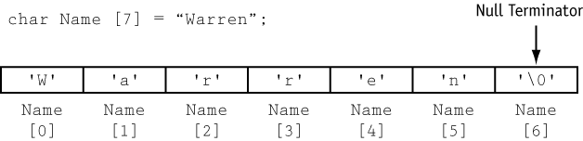
Figure 2-6

Slide 38
Program 2-9
// This program displays the contents of two char arrays.
#include <iostream.h>
void main(void)
{
char name1[] = "Holly";
char name2[] = {'W', 'a', 'r', 'r', 'e', 'n', '\0'};
cout << name1 << endl;
cout << name2 << endl;
}

Slide 39
Program Output
Holly
Warren

Slide 40
2.5 Processing Array Contents
Individual array elements are processed like any other type of variable.

Slide 41
2.6 Printing the Contents of an Array
To display the contents of an array, you must use a loop to display the contents of each element. int array[5] = { 10, 20, 30, 40, 50 }; for (int count = 0; count < 5; count++) cout << array[count] << endl;

Slide 42
Array Basic Operation

Slide 43
Insertion Concepts
Steps for Insertion:
Shift elements to create space.
Place the new element at the desired position.
Update the array size.
Considerations:
Ensure the array has sufficient capacity.
Handle index validity.

Slide 44
Example
Initial Array: [10, 20, 30, 40, 50]
Element to Insert: 25
Position: Index 2
Resulting Array: [10, 20, 25, 30, 40, 50]

Slide 45
Algorithm
Function InsertElement(array, element, position, size):
For i = size – 1 to position:
array[i + 1] = array[i] // Shift elements
array[position] = element // Insert new element
size = size + 1 // Update size

Slide 46
// C++ Program to Insert an element
// at a specific position in an Array
#include <iostream>
using namespace std;
// Function to insert x in arr at position pos
int* insertX(int n, int arr[],
int x, int pos)
{
int i;
// increase the size by 1
n++;
// shift elements forward
for (i = n; i >= pos; i--)
arr[i] = arr[i - 1];
// insert x at pos
arr[pos - 1] = x;
return arr;
}

Slide 47
// Driver Code
int main()
{
int arr[100] = { 0 };
int i, x, pos, n = 10;
// initial array of size 10
for (i = 0; i < 10; i++)
arr[i] = i + 1;
// print the original array
for (i = 0; i < n; i++)
cout << arr[i] << " ";
cout << endl;
// element to be inserted
x = 50;
// position at which element is to be inserted
pos = 5;
// Insert x at pos
insertX(n, arr, x, pos);
// print the updated array
for (i = 0; i < n + 1; i++)
cout << arr[i] << " ";
cout << endl;
return 0;
}

Slide 48
Delete elements in array
Steps for Deletion:
Identify the element to be deleted and its index.
Shift elements to overwrite the target element.
Update the array size.
Considerations:
Ensure the index to delete is valid.
The operation does not free memory in statically allocated arrays.

Slide 49
Example
Initial Array: [10, 20, 30, 40, 50]
Element to Delete: 30
Position: Index 2
Resulting Array: [10, 20, 40, 50]

Slide 50
PseudoCode
Function DeleteElement(array, position, size):
For i = position to size – 1:
array[i] = array[i + 1] // Shift elements left
size = size - 1 // Update size

Slide 51
#include <iostream>
using namespace std;
int main() {
int size, position;
cout << "Enter the size of the array: ";
cin >> size;
int array[100]; // Array with max size
cout << "Enter " << size << " elements: ";
for (int i = 0; i < size; i++)
cin >> array[i];
cout << "Enter the position (0-based index) of the element to delete: ";
cin >> position;
if (position >= size || position < 0) {
cout << "Invalid position!";
return 1;
}

Slide 52
for (int i = position; i < size - 1; i++)
array[i] = array[i + 1];
size--;
cout << "Array after deletion: ";
for (int i = 0; i < size; i++)
cout << array[i] << " ";
return 0;
}

Slide 53
Searching in Array
Initial Array: [5, 8, 12, 20, 25]
Element to Search: 20
Steps:
Compare 5 with 20 → Not Found
Compare 8 with 20 → Not Found
Compare 12 with 20 → Not Found
Compare 20 with 20 → Found (Index 3)

Slide 54
Pseudo Code
Function LinearSearch(array, size, target):
For i = 0 to size - 1:
If array[i] == target:
Return i // Element found at index i
End For
Return -1 // Element not found

Slide 55
#include <iostream>
using namespace std;
int linearSearch(int array[], int size, int target) {
for (int i = 0; i < size; i++) {
if (array[i] == target) {
return i; // Element found
}
}
return -1; // Element not found
}

Slide 56
Feedback and Reviews

